Slide 1
TOPIC 8: Lists and Tuples

Slide 2
CONTENTS
8.1 Sequences and indexing as they apply to Python lists and tuples
8.2 List Slicing
8.3 Finding Items in Lists with the in Operator
8.4 List Methods and Useful Built-in Functions
8.5 Copying Lists
8.6 Processing Lists
8.7 List Comprehensions
8.8 Two-Dimensional Lists
8.9 Tuples

Slide 3
Sequences
A sequence is an object that holds multiple items of data, stored one after the other.
You can perform operations on a sequence to examine and manipulate the items stored in it.
Introduction to Lists
A list is an object that contains multiple data items.
Lists are changeable, which means that their contents can be changed during a program’s execution.
Lists are dynamic data structures, meaning that items may be added to them or removed from them.
You can use indexing, slicing, and various methods to work with lists in a program.
numbers = [5, 10, 15, 20]
print(numbers)
In this example, the print function will display the elements of the list like this:
[5, 10, 15, 20]

Slide 4
The Repetition Operator
When the operand on the left side of the * symbol is a sequence (such as a list) and the operand on the right side is an integer, it becomes the repetition operator. The repetition operator makes multiple copies of a list and joins them all together. Here is the general format:
list * n
In the general format, list is a list, and n is the number of copies to make.
numbers = [0] * 5 Enter
print(numbers) Enter
[0, 0, 0, 0, 0]

Slide 5
Iterating over a List with the for Loop
In the general format, variable is the name of a variable, and list is the name of a list.
for variable in list:
statement
statement
etc.

Slide 6
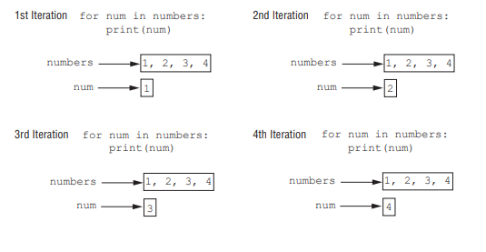
numbers = [1, 2, 3, 4]
for num in numbers:
print(num)
numbers = [1, 2, 3, 4]
for num in numbers:
num = 99
print(numbers)

Slide 7
As the for loop iterates, the index variable will be assigned the values 0, 1, 2, and 3. The
code will display the following:
Jenny
Kelly
Chloe
Aubrey
names = ['Jenny', 'Kelly', 'Chloe', 'Aubrey']
for index in range(len(names)):
print(names[index])
# The NUM_DAYS constant holds the number of
# days that we will gather sales data for.
NUM_DAYS = 5
def main():
# Create a list to hold the sales for each day.
sales = [0] * NUM_DAYS
print('Enter the sales for each day.’)
# Get the sales for each day.
for index in range(len(sales)):
sales[index] = float(input(f'Day #{index + 1}: ‘))
# Display the values entered.
print('Here are the values you entered:’)
for value in sales:
print(value)
# Call the main function.
if _ _name_ _ == '_ _main_ _':
main()
Program Output (with input shown in bold)
Enter the sales for each day.
Day #1: 1000
Day #2: 2000
Day #3: 3000
Day #4: 4000
Day #5: 5000
Here are the values you entered:
1000.0
2000.0
3000.0
4000.0
5000.0

Slide 8
List Slicing
7.9 What will the following code display?
numbers = [1, 2, 3, 4, 5]
my_list = numbers[1:3]
print(my_list)
7.10 What will the following code display?
numbers = [1, 2, 3, 4, 5]
my_list = numbers[1:]
print(my_list)
7.11 What will the following code display?
numbers = [1, 2, 3, 4, 5]
my_list = numbers[:1]
print(my_list)
7.12 What will the following code display?
numbers = [1, 2, 3, 4, 5]
my_list = numbers[:]
print(my_list)
7.13 What will the following code display?
numbers = [1, 2, 3, 4, 5]
my_list = numbers[−3:]
print(my_list)
A slicing expression selects a range of elements from a sequence.
list_name[start : end]
days = ['Sunday', 'Monday', 'Tuesday', 'Wednesday’, 'Thursday', 'Friday', 'Saturday’]
The following statement uses a slicing expression to get the elements from indexes 2 up to, but not including, 5:
mid_days = days[2:5]
After this statement executes, the mid_days variable references the following list:
['Tuesday', 'Wednesday', 'Thursday']
7.9 [2, 3]
7.10 [2, 3,4,5]
7.11 [1]
7.12 [1, 2, 3, 4, 5]
7.13 [3, 4, 5]

Slide 9
Finding Items in Lists with the in Operator
You can use the in operator to determine whether an item is contained in a list. Here is the general format of an expression written with the in operator to search for an item in a list:
item in list
# This program demonstrates the in operator
# used with a list.
def main():
# Create a list of product numbers.
prod_nums = ['V475', 'F987', 'Q143', 'R688’]
# Get a product number to search for.
search = input('Enter a product number: ‘)
# Determine whether the product number is in the list.
if search in prod_nums:
print(f'{search} was found in the list.’)
else:
print(f'{search} was not found in the list.')
# Call the main function.
if _ _name_ _ == '_ _main_ _':
main()
Program Output
Enter a product number: Q143
Q143 was found in the list.
Program Output
Enter a product number: B000
B000 was not found in the list.

Slide 10
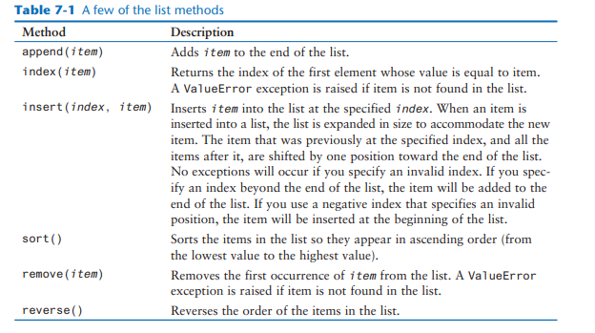
List Methods and Useful Built-in Functions
Lists have numerous methods that allow you to work with the elements that they contain. Python also provides some built-in functions that are useful for working with lists.

Slide 11
# This program demonstrates how the append
# method can be used to add items to a list.
def main():
# First, create an empty list.
name_list = []
# Create a variable to control the loop.
again = 'y'
# Add some names to the list.
while again == 'y':
# Get a name from the user.
name = input('Enter a name: ')
# Append the name to the list.
name_list.append(name)
# Add another one?
print('Do you want to add another name?')
again = input('y = yes, anything else = no: ')
print()
# Display the names that were entered.
print('Here are the names you entered.')
for name in name_list:
print(name)
# Call the main function.
if _ _name_ _ == '_ _main_ _':
main()
Program Output
Enter a name: Kathryn
Do you want to add another name?
y = yes, anything else = no: y
Enter a name: Chris
Do you want to add another name?
y = yes, anything else = no: y
Enter a name: Kenny
Do you want to add another name?
y = yes, anything else = no: y
Enter a name: Renee
Do you want to add another name?
y = yes, anything else = no: n
Here are the names you entered.
Kathryn
Chris
Kenny
Renee

Slide 12
Copying Lists
# Create a list.
list1 = [1, 2, 3, 4]
# Assign the list to the list2 variable.
list2 = list1

Slide 13
Processing lists
# This program calculates the total of the values
# in a list.
def main():
# Create a list.
numbers = [2, 4, 6, 8, 10]
# Create a variable to use as an accumulator.
total = 0
# Calculate the total of the list elements.
for value in numbers:
total += value
# Display the total of the list elements.
print(f'The total of the elements is {total}.')
# Call the main function.
if _ _name_ _ == '_ _main_ _':
main()
Program Output
The total of the elements is 30.

Slide 14
question
Ms. Seena gives a series of exams during the semester in her chemistry class. At the end of the semester, she drops each student’s lowest test score before averaging the scores. She has asked you to design a program that will read a student’s test scores as input and calculate the average with the lowest score dropped. Here is the algorithm that you developed:
Get the student’s test scores.
Calculate the total of the scores.
Find the lowest score.
Subtract the lowest score from the total. This gives the adjusted total.
Divide the adjusted total by 1 less than the number of test scores. This is the average.
Display the average.

Slide 15

List Comprehensions
A list comprehension is a concise expression that creates a new list by iterating over the elements of an existing list.
list1 = [1, 2, 3, 4]
list2 = []
for item in list1:
list2.append(item)
In this code, each time the loop iterates, it appends an element of list1 to list2. After this code executes, list2 will reference a copy of list1.
list1 = [1, 2, 3, 4]
list2 = []
for item in list1:
list2.append(item**2)
The following code shows how the same operation can be performed with a list comprehension:
list1 = [1, 2, 3, 4]
list2 = [item**2 for item in list1]
list2 will contain the values [1, 4, 9, 16]

Slide 16
Two-Dimensional Lists
A two-dimensional list is a list that has other lists as its elements.
1 # This program demonstrates a two-dimensional list.
2
3 def main():
4 # Create a two-dimensional list.
5 values = [[1, 2, 3],
6 [10, 20, 30],
7 [100, 200, 300]]
8
9 # Display the list elements.
10 for row in values:
11 for element in row:
12 print(element)
13
14 # Call the main function.
15 if _ _name_ _ == '_ _main_ _':
16 main()
Program Output
1
2
3
10
20
30
100
200
300

Slide 17
1 # This program assigns random numbers to
2 # a two-dimensional list.
3 import random
4
5 # Constants for rows and columns
6 ROWS = 3
7 COLS = 4
8
9 def main():
10 # Create a two-dimensional list.
11 values = [[0, 0, 0, 0],
12 [0, 0, 0, 0],
13 [0, 0, 0, 0]]
14
15 # Fill the list with random numbers.
16 for r in range(ROWS):
17 for c in range(COLS):
18 values[r][c] = random.randint(1, 100)
19
20 # Display the random numbers.
21 print(values)
22
23 # Call the main function.
24 if _ _name_ _ == '_ _main_ _':
25 main()
Program Output
[[4, 17, 34, 24], [46, 21, 54, 10], [54, 92, 20, 100]]

Slide 18
Tuples
A tuple is an immutable sequence, which means that its contents cannot be changed.
>>> my_tuple = (1, 2, 3, 4, 5) Enter
>>> print(my_tuple) Enter
(1, 2, 3, 4, 5)

